Slide 1
Effects of Vorinostat on Cancer Treatment
Project Proposal:

Slide 2
NCI Transcriptional Pharmacodynamics Workbench
Cell lines
NCI-60
15 anticancer agens
12.704
genes

Slide 3
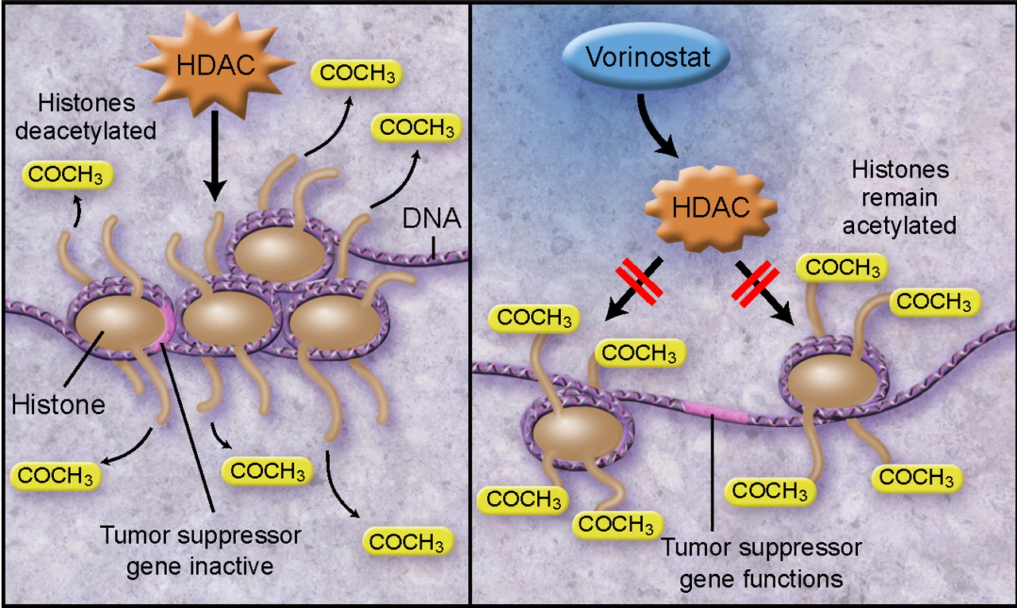
Our focus: Vorinostat
tardust.bio

Slide 4



Project Steps

Slide 5
Broad Analysis
Different chemotherapy agents
Cell lines NCI-60|15 anticancer agens|12.704genes

Slide 6
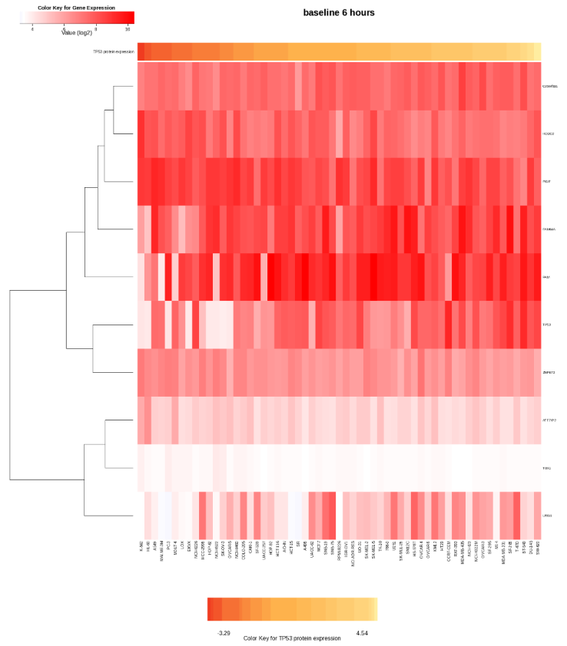
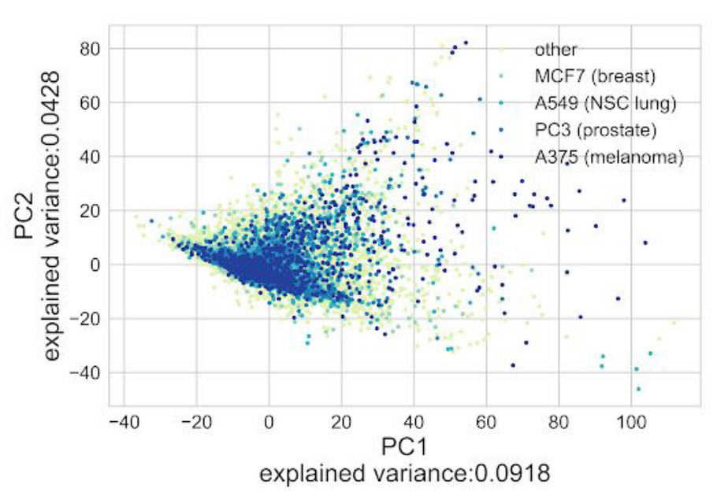

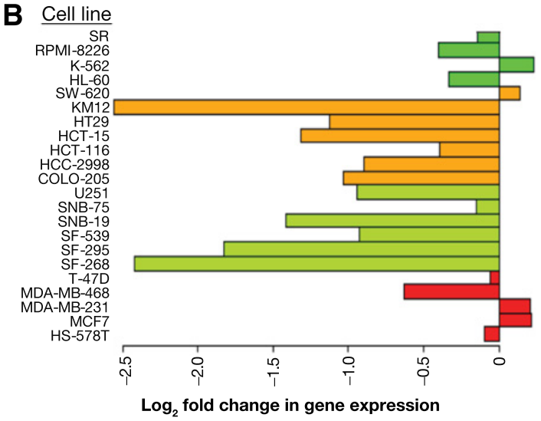
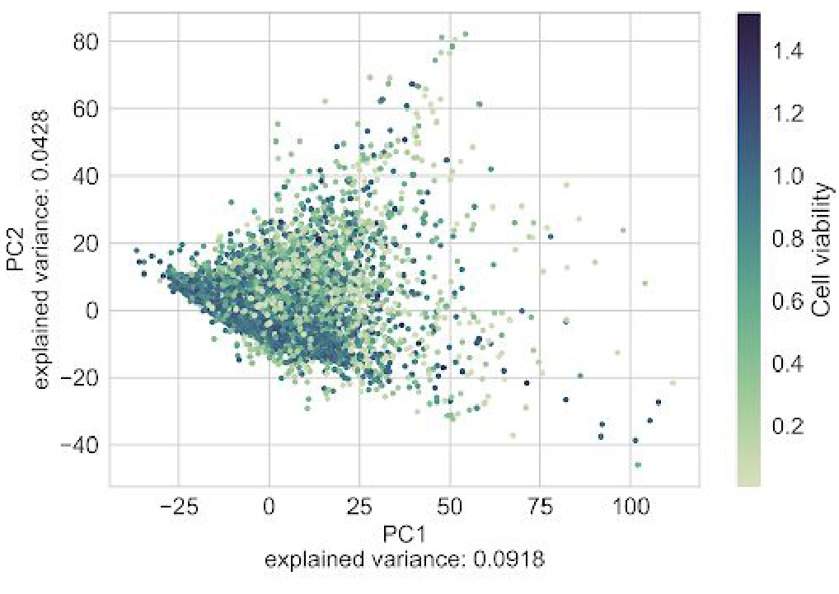
a) Gene expression profiles
b) Space of gene expression
c) Individual gene expression signatures
d) Exploratory analysis on the matrix of log2 FC

Slide 7

Gene expression profiles

Slide 8
Specific analysis
Vorinostat as a chemotherapy agent
NIH LINCS Program| NCI Transcriptional Pharmacodynamics Workbench | CCLE data portal

Slide 9
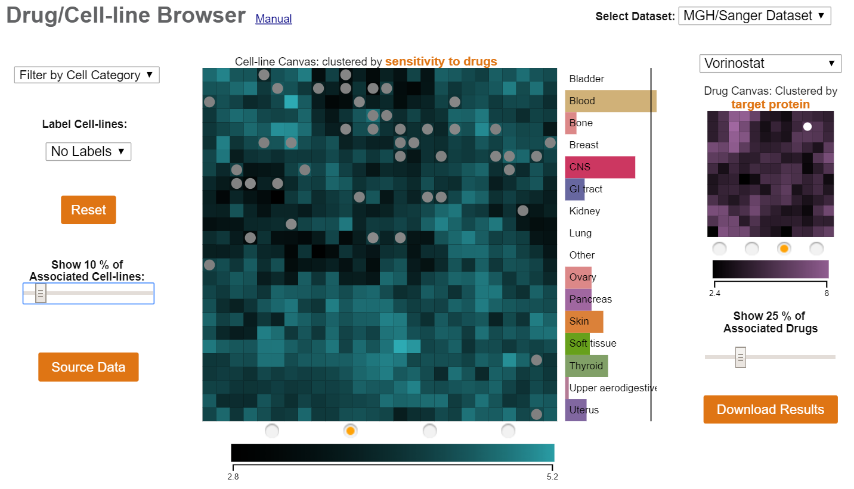
DATA ENRICHMENT
Main factors driving drug sensitivity and collection of drug response biomarkers data
www.maayanlab.net
Notes:
DCB can help in understanding drug response patterns and prioritize drug/cancer-cell-line interactions by tissue of origin or cancer subtype. The collected drug sensitivity data provides suggestive treatment for different types of cancer. Here the cell line canvas (big square) shows similar cell lines clustered by response to vorinostat. The Drug canvas shows different drugs clustered by similar known target. The gray circles show the most sensitive cell lines to the drug. Brighter always means better clustered.

Slide 10
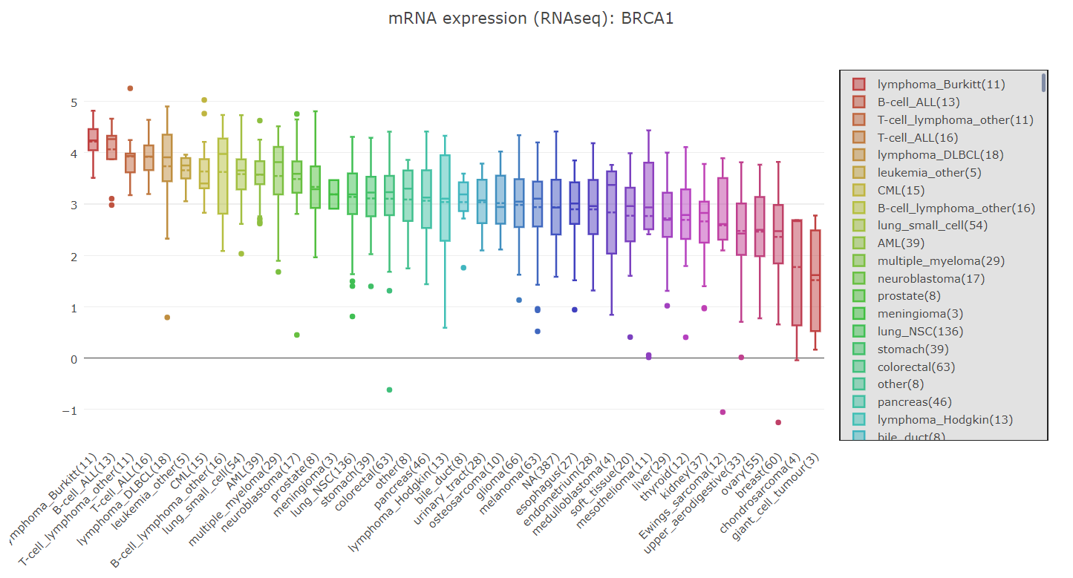
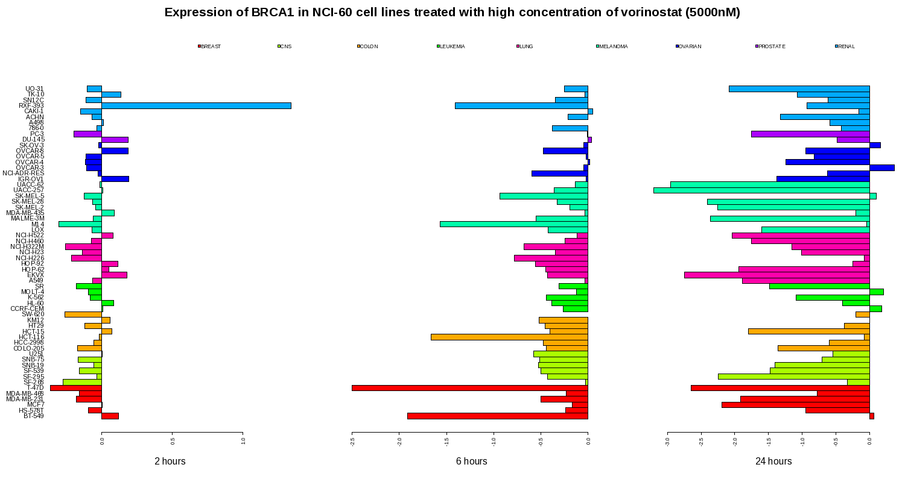
DATA ENRICHMENT
Main factors driving drug sensitivity and collection of drug response biomarkers data
portals.broadinstitute.org
tpwb.nci.nih.gov
Notes:
CCLE showing cancer types and their basal mRNA espression of the gene BRCA1.
BRCA1 and treatmnet with Vorinostat (NCI-60 data base)
Vorinostat depletes the BRCA1 expression levels. BRCA1 is a tumor suppressor gene responsible for DNA repair

Slide 11
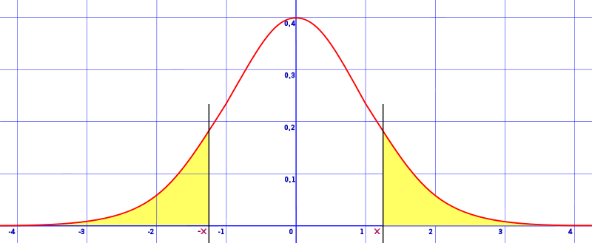

Transcriptional Changes & Drug Sensitivity
“Which genes in which celllines can be used as biomarkers?“
T-test
paired and two-sided
H0: “The gene expression does not change significantly after drug exposure“
www.statisticshowto.datasciencecentral.com
H
biomarkers for each cellline

Slide 12


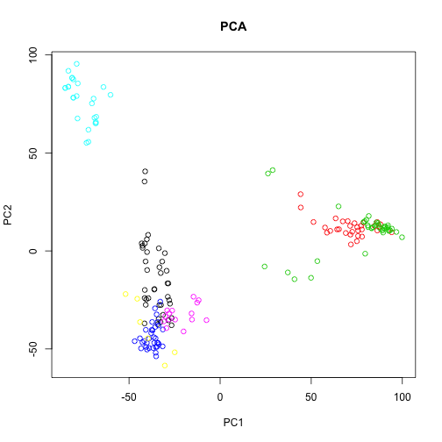
“Find groups of most significant genes“
→ Fold change
http://genomicsclass.github.io

Slide 13

Transcriptional Changes & Drug Sensitivity
“Which genes in which celllines can be used as biomarkers?“
T-test
paired and two-sided
H0: “The gene expression does not change significantly after drug exposure“
find general biomarkers
→ representative for most celllines
www.statisticshowto.datasciencecentral.com
H
biomarkers for each cellline
PCA

Slide 14



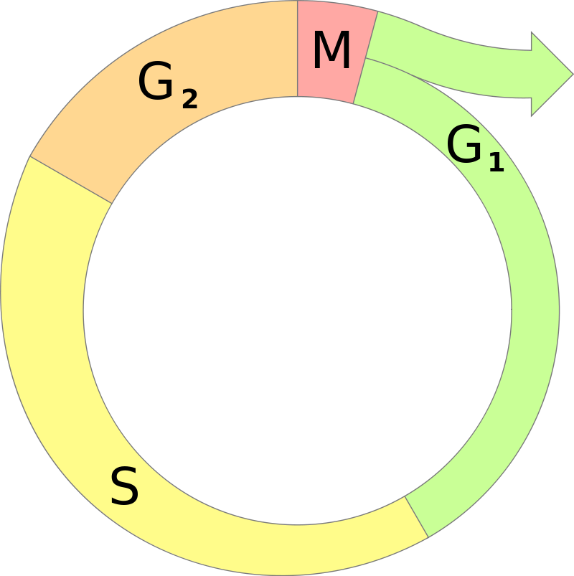




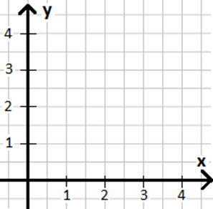

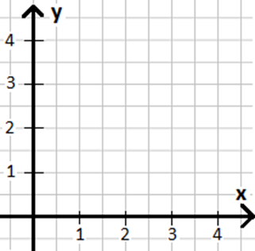

Transcriptional Changes & Drug Sensitivity
“Can we predict drug sensitivity with doubling time?“
Understand connections :
biomarker expression
sensitivity
linear regression
doubling time
apps.derstandard.de
sensitivity
„Can we predict drug sensitivity with copy number of biomarkers?“
doubling time
copy number

Slide 15
Biomarkes
Drug senitivity

Slide 16
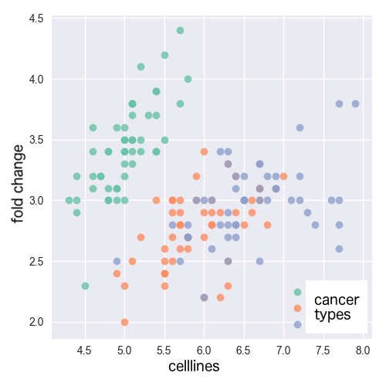
Is there a connection between the effectiveness of the drug and the cell line? For which types of cancer can Vorinostat possibly be used?
www.d3-graph-gallery.com, edited

Slide 17
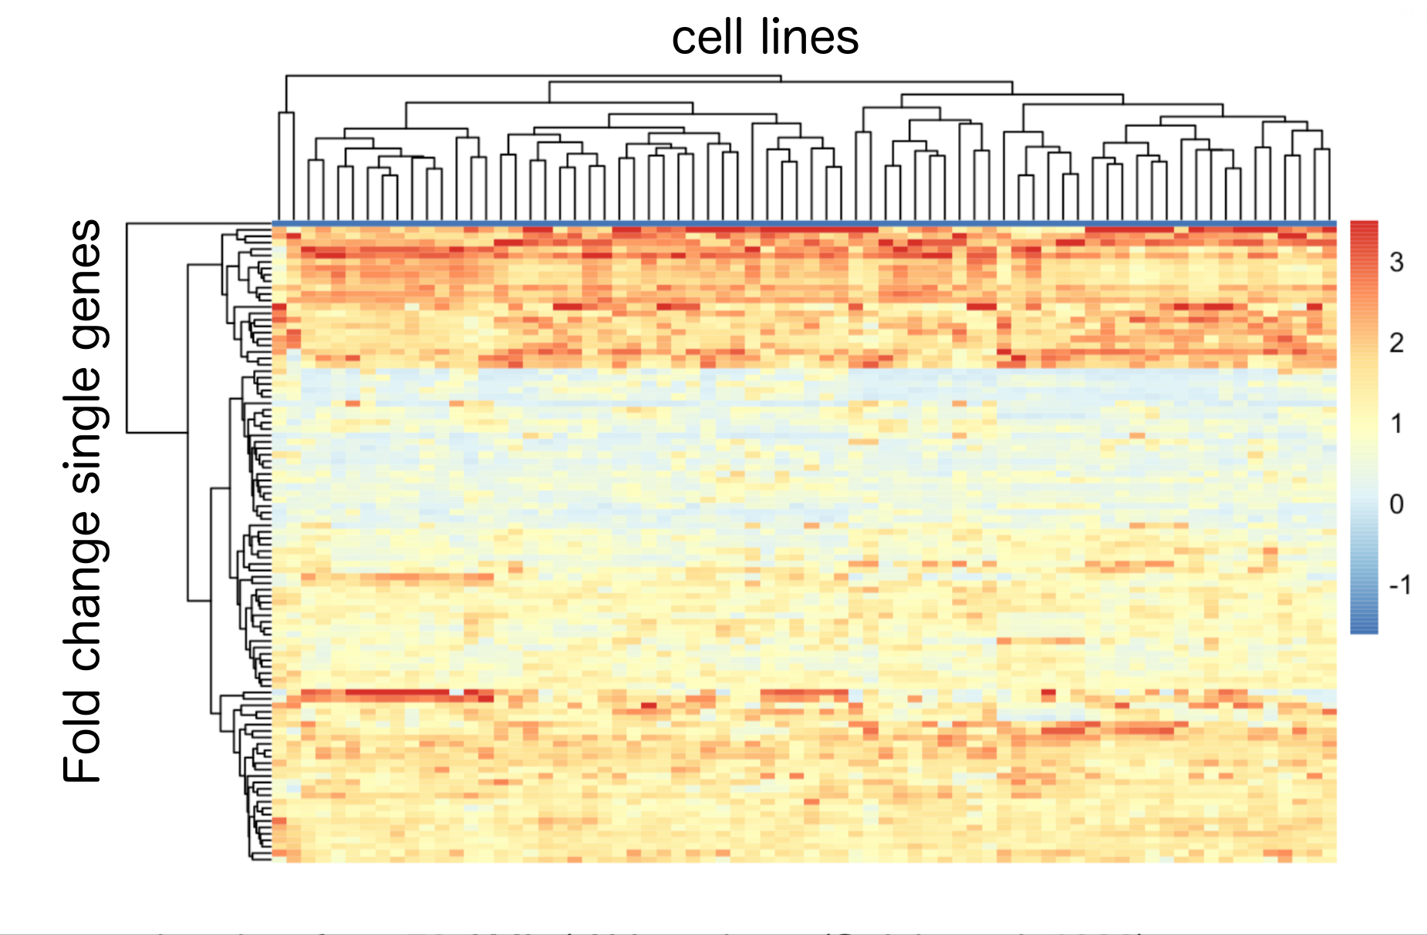
Is there a connection between the effectiveness of the drug and the cell line? For which types of cancer can Vorinostat possibly be used?
bioinfo.ipmb.uni-heidelberg.de/crg/datascience3fs, edited

Slide 18
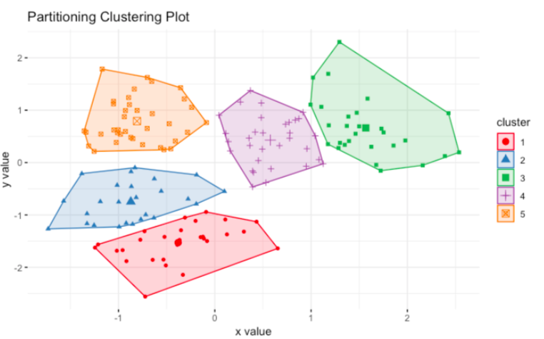
Is there a connection between the effectiveness of the drug and the cell line? For which types of cancer can Vorinostat possibly be used?
bioinfo.ipmb.uni-heidelberg.de/crg/datascience3fs, edited

Slide 19
Cancer types

Slide 20
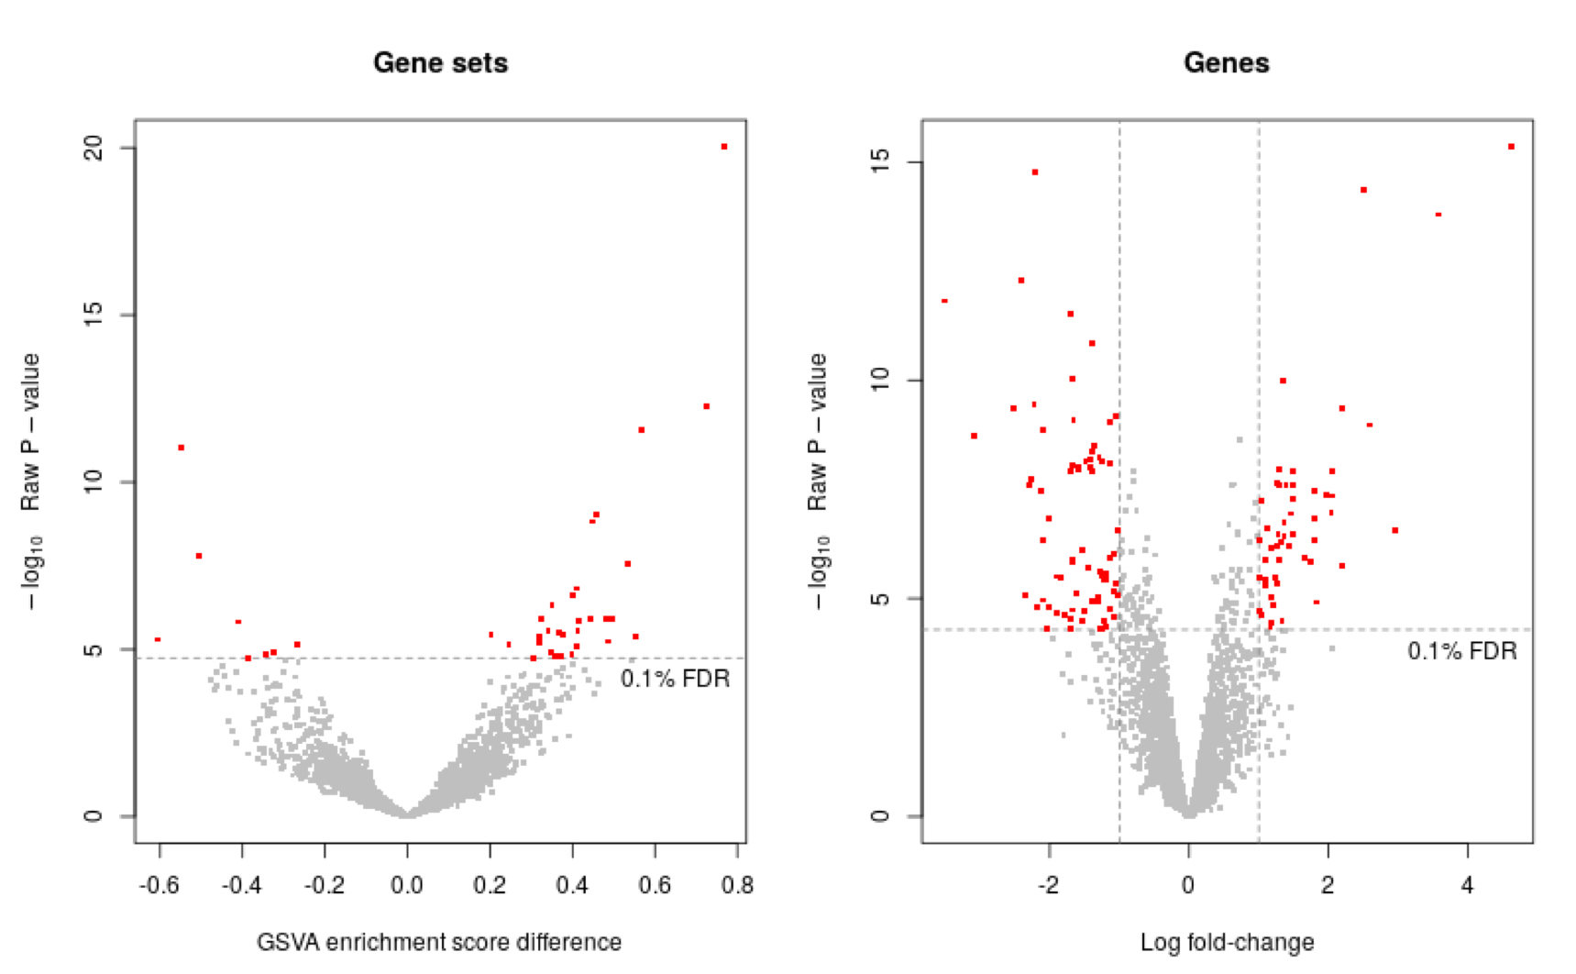
Which pathways does Vorinostat interfere with the most? Are the pathways connected?
(Hänzelmann et al., 2013)

Slide 21
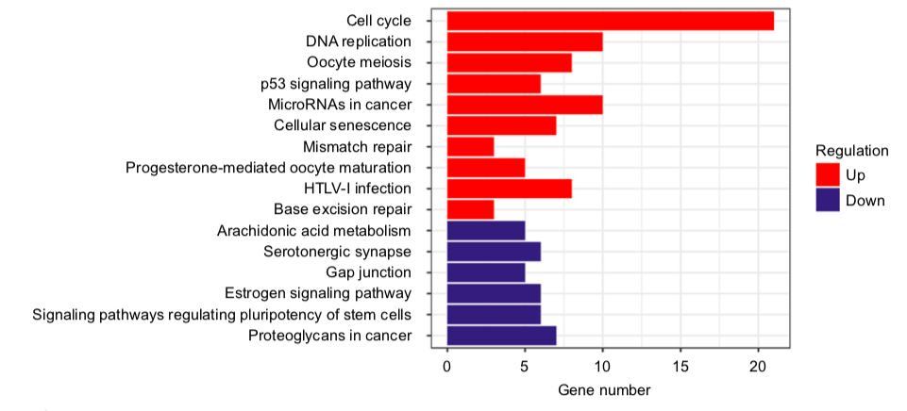
Which pathways does Vorinostat interfere with? Are the pathways connected?
(Tang et al., 2018)

Slide 22
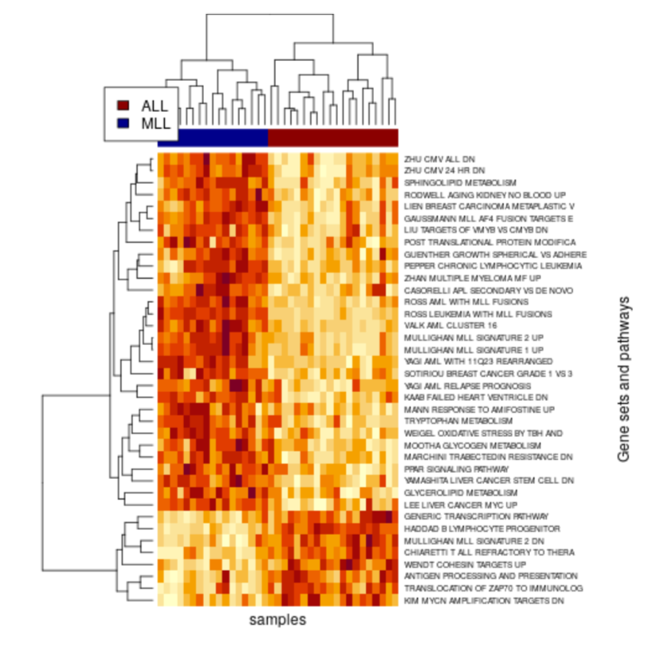
Which pathways does Vorinostat interfere with? Are the pathways connected?
(Hänzelmann et al., 2013)

Slide 23
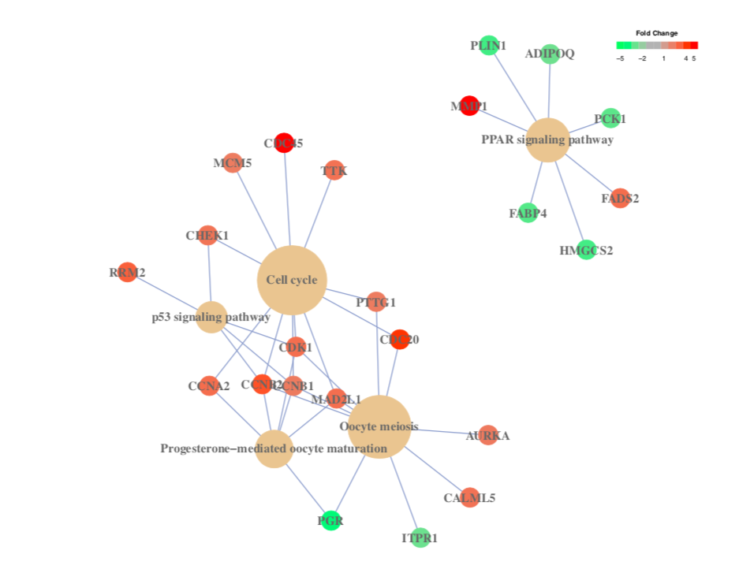
Which pathways does Vorinostat interfere with? Are the pathways connected?
(Yu et al., 2012)

Slide 24
Affected pathways

Slide 25
Timeline
2 Weeks
2 Weeks
3 Weeks
1 Week
affected Pathways
Cancer types
Drug sensitvity
Biomarkers
Gene expression profiles

Slide 26

Effects of Vorinostat in Cancer Treatment

Slide 27
Backup

Slide 28
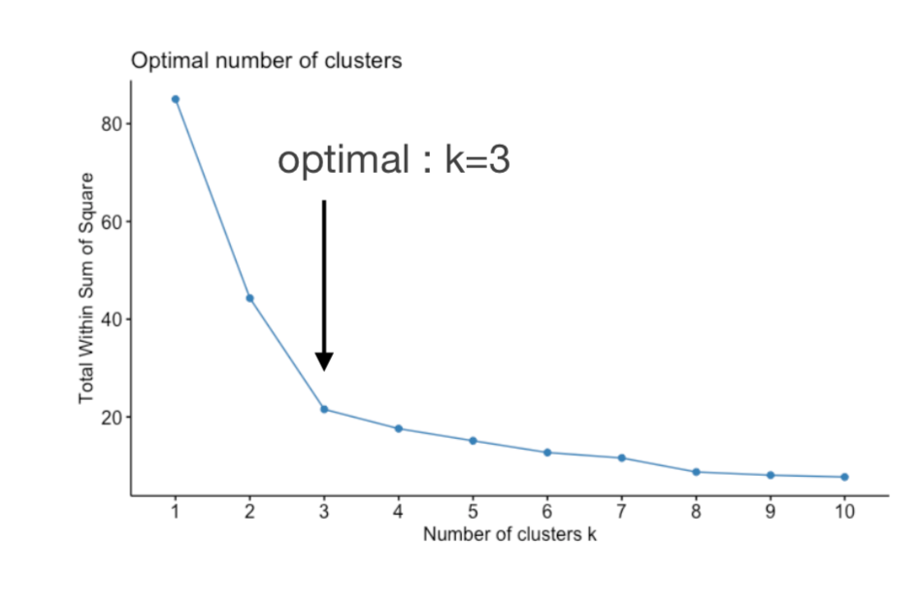
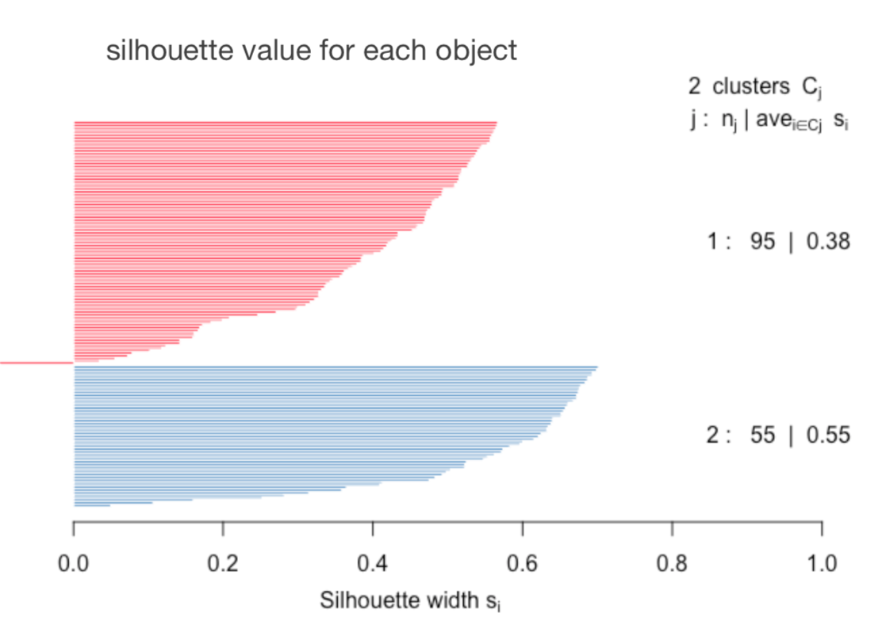
K means quality

Slide 29
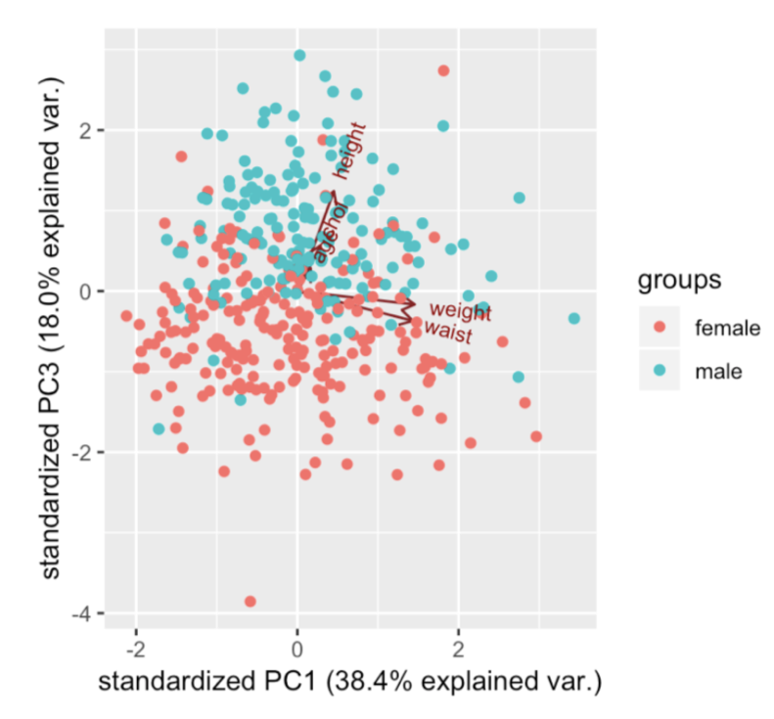
Is there a connection between the effectiveness of the drug and the cell line? For which types of cancer can Vorinostat possibly be used?
Cancer types
bioinfo.ipmb.uni-heidelberg.de/crg/datascience3fs, edited

Slide 30
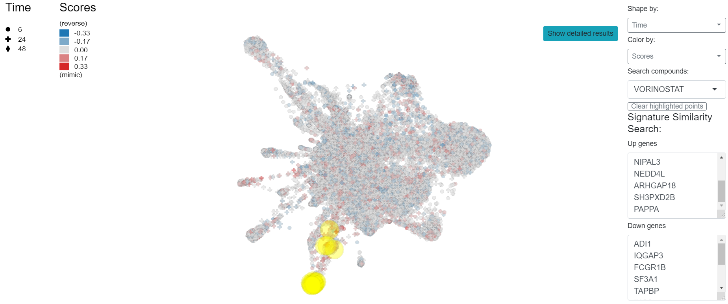
DATA ENRICHMENT
Main factors driving drug sensitivity and collection of drug response biomarkers data
amp.pharm.mssm.edu
Notes:
L1000FWD Large Scale Visualization of Drug Induced Transcriptomic Signatures: Induced gene expression signatures (list of genes sharing a common pattern of expression that can be employed to classify groups of samples in any independent dataset). Serves mostly to identify function of unknown molecules, can be used to find new functions by k means clustering of vorinostat.

Slide 31
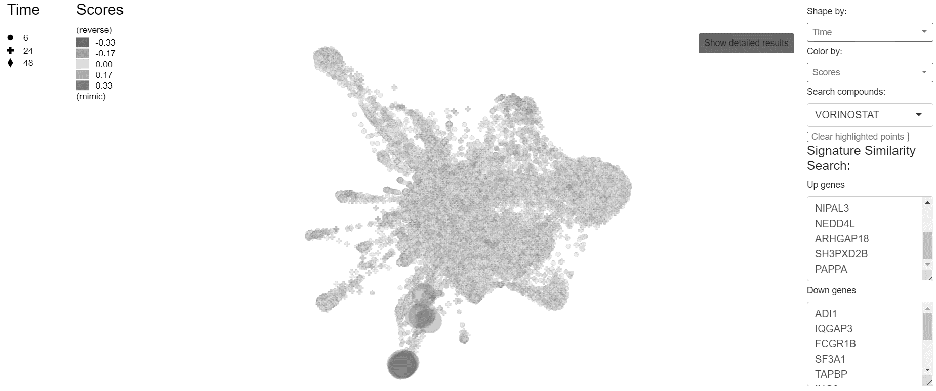
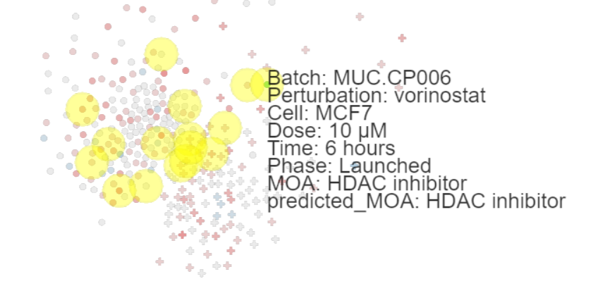
DATA ENRICHMENT
Main factors driving drug sensitivity and collection of drug response biomarkers data

